Slide 1
AIRPORT SIMULATOR
Team 8: Dungeon Masters
Unrestricted

Slide 2
Problem Statement
We are responsible for designing a new airport. One of the key decision is to decide how many gates the new airport should have. This decision depends on how many flights the airport can handle safely without congestion. We have to simulate airport traffic (holding, take off, landing, scheduling, emergency lands). The parts of the traffic control simulation system that we write may be reused later for real traffic control system for the same airport.

Slide 3
Content
Primary requirements
Application requirements
Functional
Non-functional
Use case

Slide 4
Primary Requirements
City/Location and its demographics.
Flight requirements:
Passenger Capacity
Time taken by flight from runway to gate.
Onboarding time.
Offboarding time.
Standing time.

Slide 5
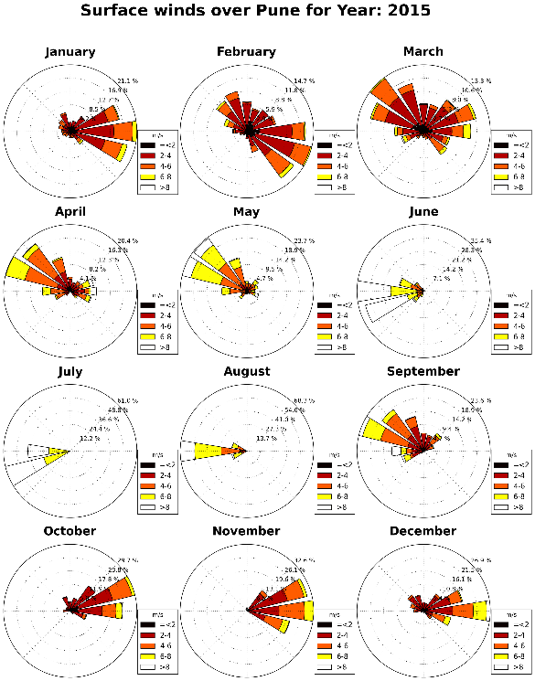
Assumptions
1 | City | Pune
2 | Population (Pune city) | 3.12 million
3 | Average elevation of sight | 592 meters
4 | Wind rose diagram
5 | Assumed initial traffic | 2400 passengers/day
Image Source: Google

Slide 6
Functional Requirements
Sr No | Requirements | Priority
1 | The system should be able to come up with optimum number of gates the airport should have so that there will be no congestion. | Required
2 | In case of emergency, the system will be able to determine how many emergency flights it can accommodate at a given situation. | Required
3 | Graph representation of number of gates plotted against number of people, number of flights. | Desired
4 | There will be provision for feeding information mentioned in Primary Requirements(Slide #4) through questions and answers on a terminal. | Required

Slide 7
Non-Functional Requirements
Sr No | Requirements
1 | Modularity: 1. System will be modular so that it can be further extended. 2. Modules can be reused in any other application wherever applicable.

Slide 8
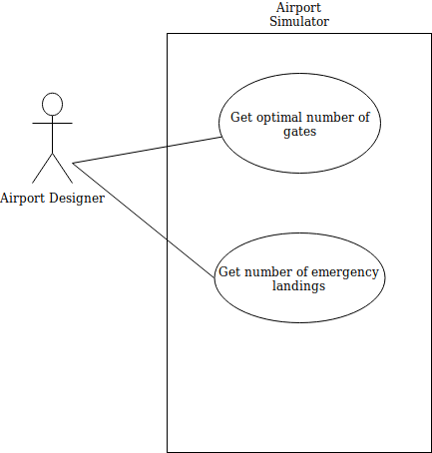
Usecase Diagram:

Slide 9
Thank You

